Slide 1
LESSON 6
BOOK CHAPTERS 24 and 25
ELECTRIC POTENTIAL and CAPACITANCE

Slide 2
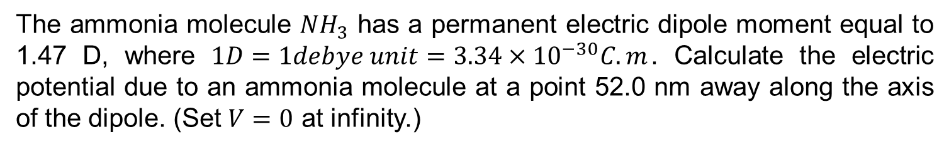
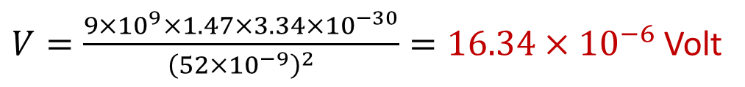

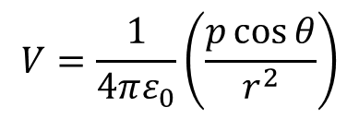


Problem 21 (Book Chapter 24)
The ammonia molecule ${NH}_{3}$ has a permanent electric dipole moment equal to 1.47 D, where $1D=1debye unit=3.34×{10}^{−30}C.m$. Calculate the electric potential due to an ammonia molecule at a point 52.0 nm away along the axis of the dipole. (Set $V=0$ at infinity.)
Answer:
We have
Given
$$p=1.47 D=1.47×{3.34×10}^{−30} C−m$$
$$V=\frac{1}{4πε_{0}}\left(\frac{p\cos{θ}}{r^{2}}\right)$$
$$r=52 nm=52×{10}^{−9} m$$
$$θ=0^{0} and\cos{0^{0}}=1$$
$$V=?$$
$V=\frac{{9×10}^{9}×1.47×3.34×{10}^{−30}}{{\left(52×{10}^{−9}\right)}^{2}}=16.34×{10}^{−6}$ Volt

Slide 3
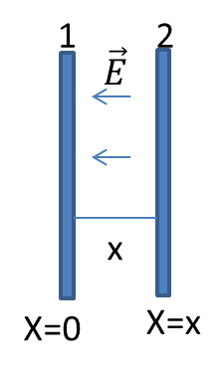



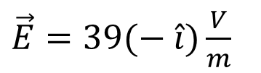
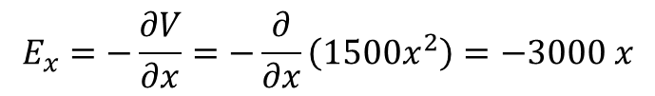
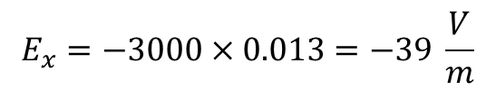

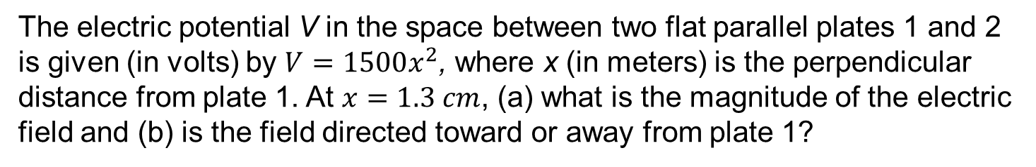


Problem 36 (Book Chapter 24)
The electric potential V in the space between two flat parallel plates 1 and 2 is given (in volts) by $V=1500x^{2}$, where x (in meters) is the perpendicular distance from plate 1. At $x=1.3 cm$, (a) what is the magnitude of the electric field and (b) is the field directed toward or away from plate 1?
(a) We have
Given
$$E_{x}=−\frac{∂V}{∂x}=−\frac{∂}{∂x}\left(1500x^{2}\right)=−3000 x$$
$$V=1500 x^{2}$$
$$E_{x}=−3000×0.013=−39 \frac{V}{m}$$
At x = 1.3 cm= 0.013 m ,
$$E=?$$
$\vec{E}=E_{x}\hat{i}=39(− \hat{i}$ )
The direction of electric field,
Magnitude of $\vec{E}$ is
$$\vec{E}=?$$
$E=39 \frac{V}{m}$
(b) The direction of electric field is toward plate 1, because
$\vec{E}=39(− \hat{i})\frac{V}{m}$

Slide 4

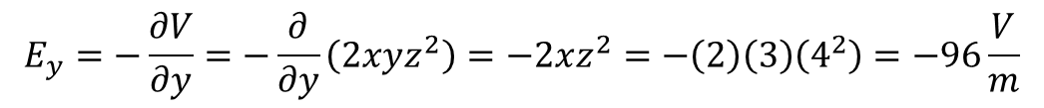

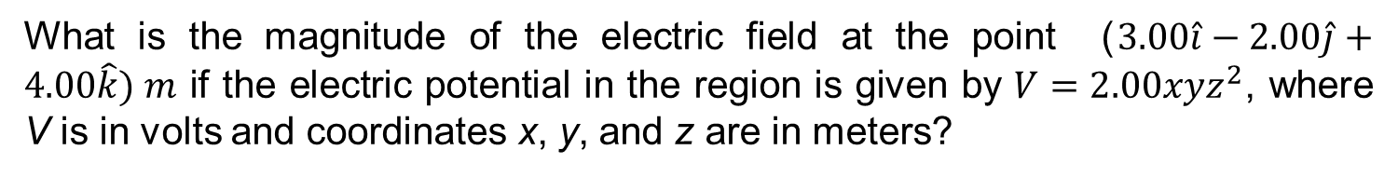

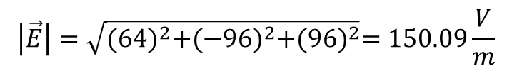
Problem 37 (Book Chapter 24)
What is the magnitude of the electric field at the point ($3.00\hat{i}−2.00\hat{j}+4.00\hat{k}) m$ if the electric potential in the region is given by $V=2.00xyz^{2}$, where V is in volts and coordinates x, y, and z are in meters?
Answer:
We know
$$E_{x}=−\frac{∂V}{∂x}=−\frac{∂}{∂x}\left(2xyz^{2}\right)=−2yz^{2}=−\left(2\right)\left(−2\right)\left(4^{2}\right)=64\frac{V}{m}$$
Given
$$E_{y}=−\frac{∂V}{∂y}=−\frac{∂}{∂y}\left(2xyz^{2}\right)=−2xz^{2}=−\left(2\right)\left(3\right)\left(4^{2}\right)=−96\frac{V}{m}$$
$$V=2xyz^{2}$$
And
$$E_{z}=−\frac{∂V}{∂z}=−\frac{∂}{∂z}\left(2xyz^{2}\right)=−4xyz=−\left(4\right)(3)\left(−2\right)\left(4\right)=96\frac{V}{m}$$
$\left(x,y,z\right)=(3,−2$, 4)
$$\left|\vec{E}\right|=?$$
$$\vec{E}=E_{x}\hat{i}+E_{y}\hat{j}+E_{z}\hat{k}=64\hat{i}−96\hat{j}+96\hat{k}$$
Therefore,
$$\left|\vec{E}\right|=\sqrt{{(64)}^{2}+{(−96)}^{2}+{(96)}^{2}}=150.09\frac{V}{m}$$

Slide 5
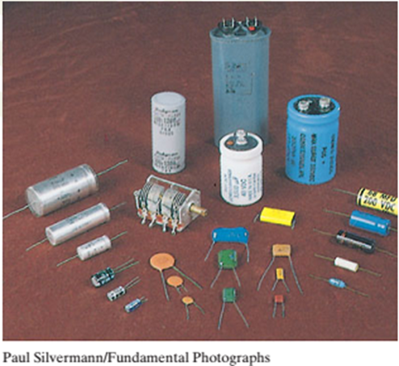
BOOK CHAPTER 25
CAPACITANCE
An assortment of capacitors.

Slide 6
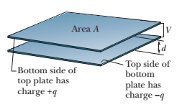

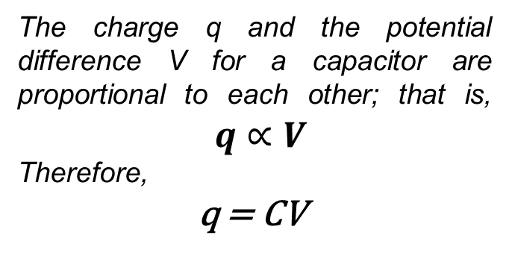
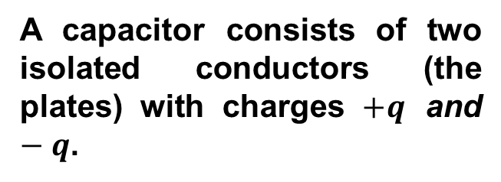
Capacitance
A capacitor consists of two isolated conductors (the plates) with charges $+q$ and $−q$.
The charge q and the potential difference V for a capacitor are proportional to each other; that is, $q∝V$
Therefore,
q = CV
The proportionality constant C is called the capacitance of the capacitor.
The value of C depends only on the geometry of the plates and not on their charge or potential difference. The capacitance is a measure of how much charge must be put on the plates to produce a certain potential difference between them: The greater the capacitance, the more charge is required.
$$C=\frac{q}{V}$$
The SI unit of capacitance is the coulomb per volt. Common name is Farad (F):

Slide 7
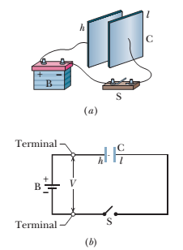
Charging a Capacitor:
(a) Battery B, switch S, and plates h and l of capacitor C, connected in a circuit.
(b) A schematic diagram with the circuit elements represented by their symbols.

Slide 8
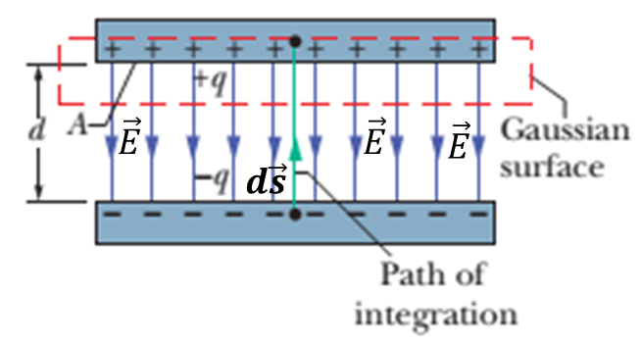

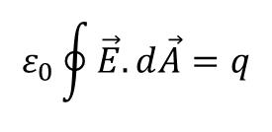

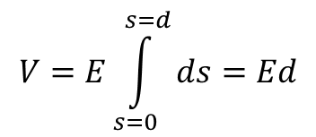


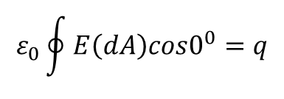
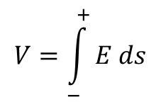

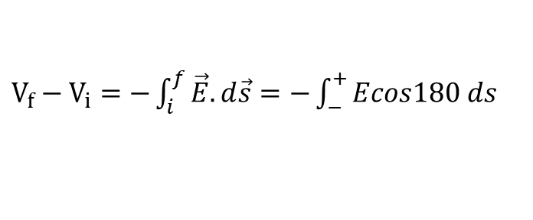
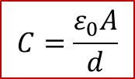
Calculating the Capacitance: A parallel-Plate Capacitor:
Applying Gauss’ Law:
$$ε_{0}\oint{\vec{E}.d\vec{A}=q}$$
Here q is the charge enclosed by a Gaussian
surface and is the net electric flux
through that surface.
$$\oint{\vec{E}.d\vec{A}}$$
$$ε_{0}\oint{E\left(dA\right)cos0^{0}=q}$$
Since
$\vec{E} and d\vec{A}$ are parallel
Therefore,
$$ε_{0}EA=q$$
A is the area of that part of the Gaussian surface through which there is a flux.
The potential difference between the plates of a capacitor is related to the field $\vec{E}$ by
$V_{f}−V_{i}=−\int_{i}^{f}{\vec{E}.d\vec{s}}=−\int_{−}^{+}{Ecos180 ds}$
$$V=E\int_{s=0}^{s=d}{ds}=Ed$$
$$V=\int_{−}^{+}{E ds}$$
Where,
$${V=V}_{f}−V_{i}$$
We have $C=\frac{q}{V}=\frac{ε_{0}EA}{Ed}=\frac{ε_{0}A}{d}$
$$C=\frac{ε_{0}A}{d}$$

Slide 9
Thank You

